Slide 1

R E / M A X E S T A T E P R O P E R T I E S
Market Update
Aug 10, 2021
Presented by James Sanders

Slide 2
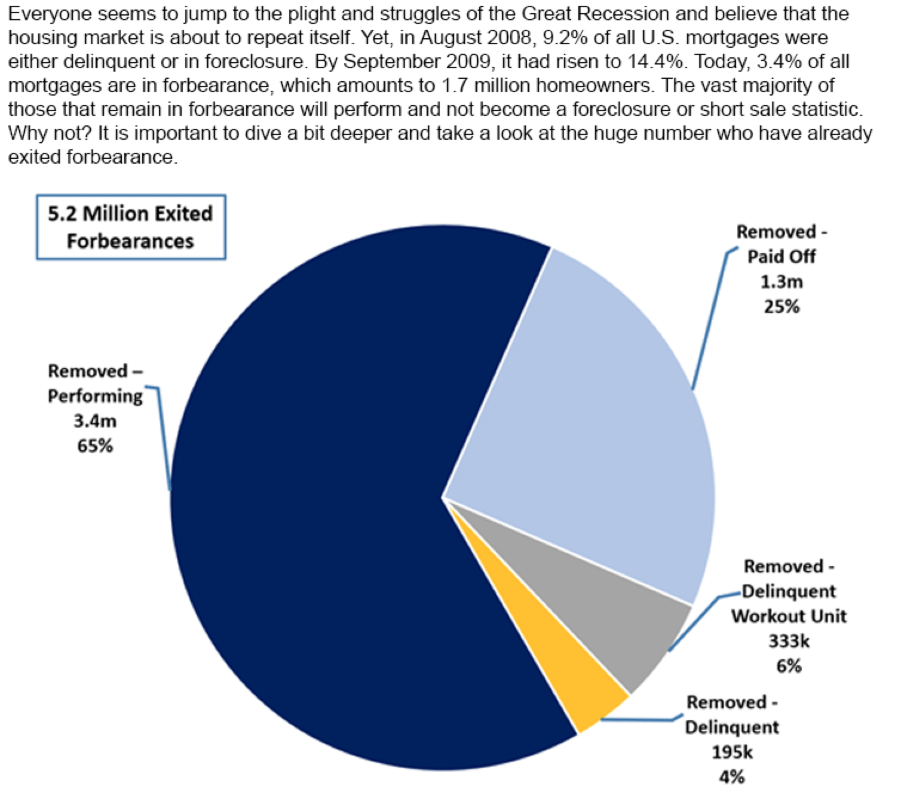

Slide 3
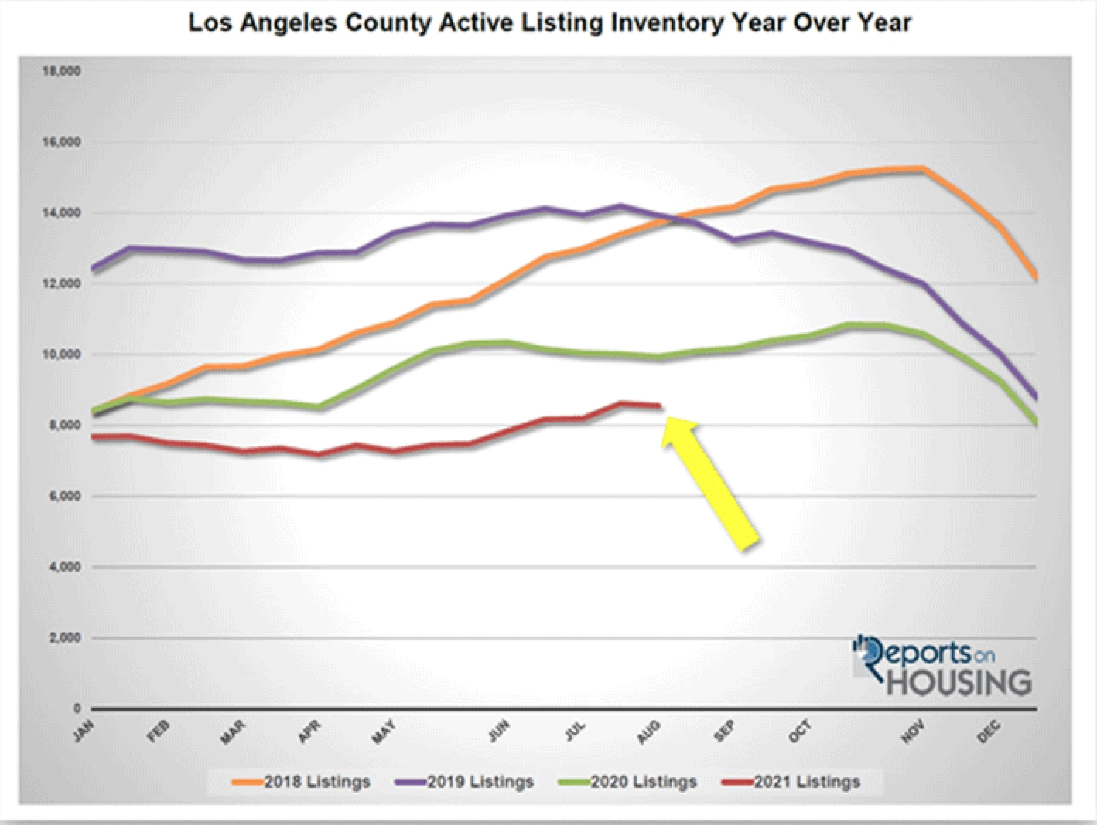

Slide 4
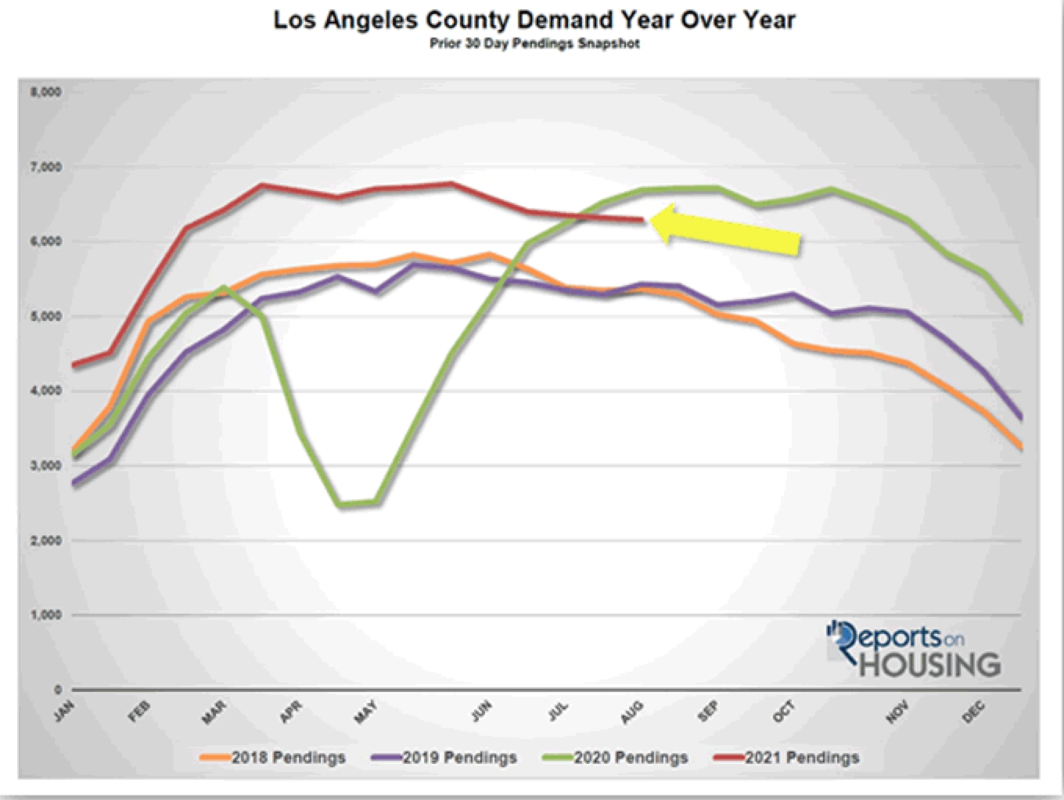

Slide 5
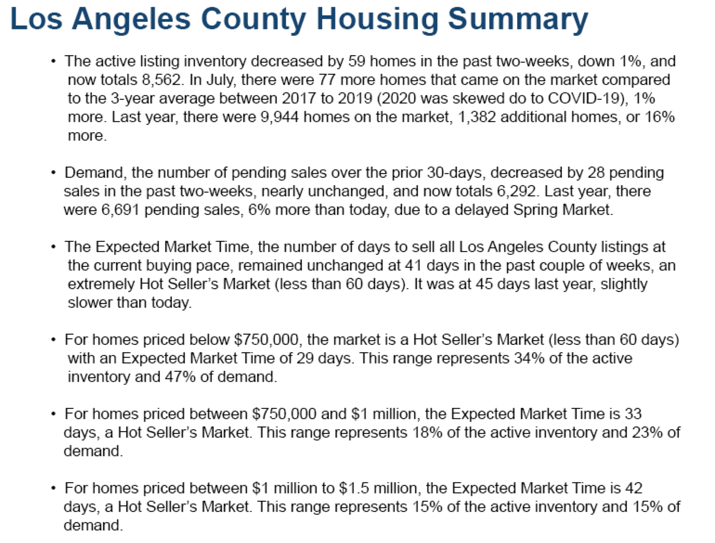

Slide 6
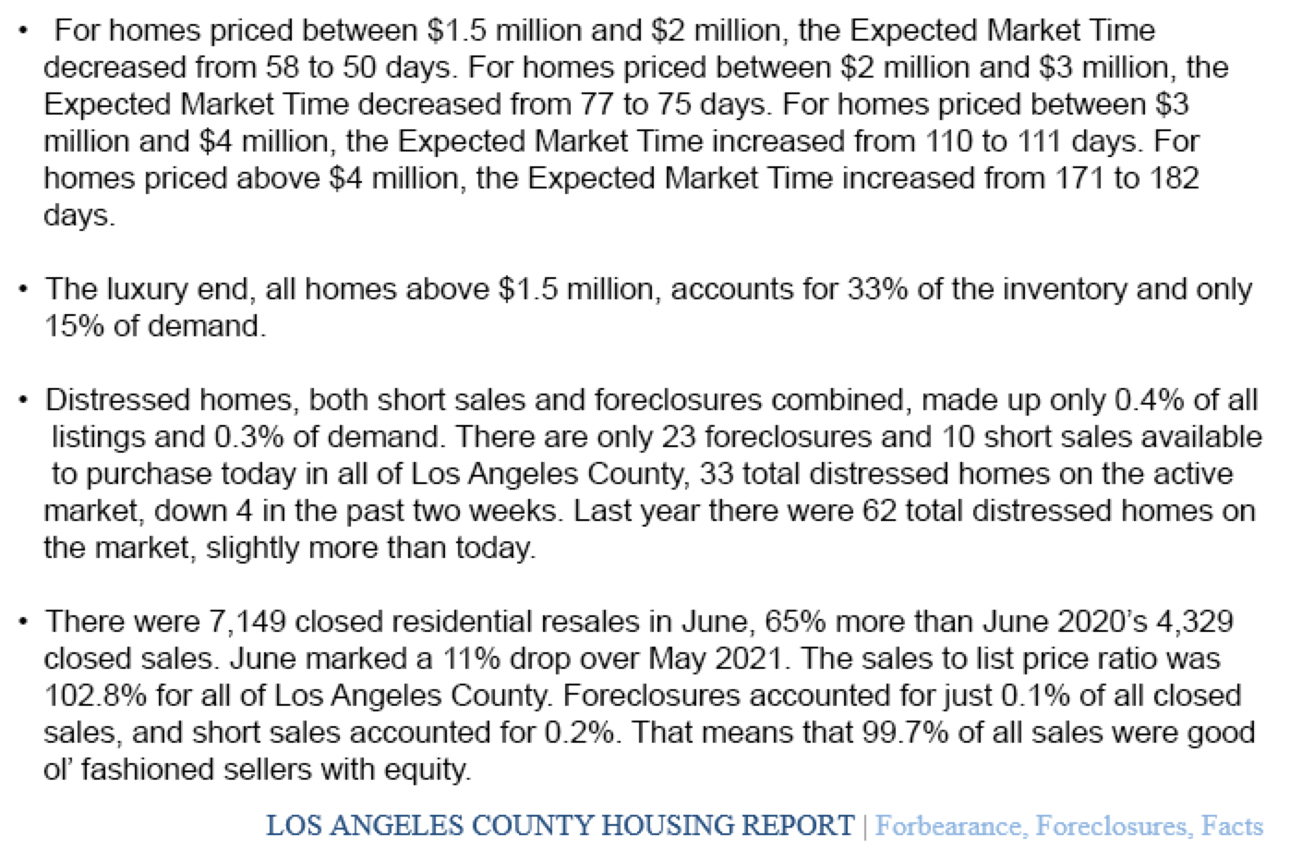

Slide 7
R E / M A X E S T A T E P R O P E R T I E S
TOP PRODUCERS JULY 2021
Presented by James Sanders

Slide 8

TOP AGENTS + TOP TEAMS
MANHATTAN BEACH

Slide 9
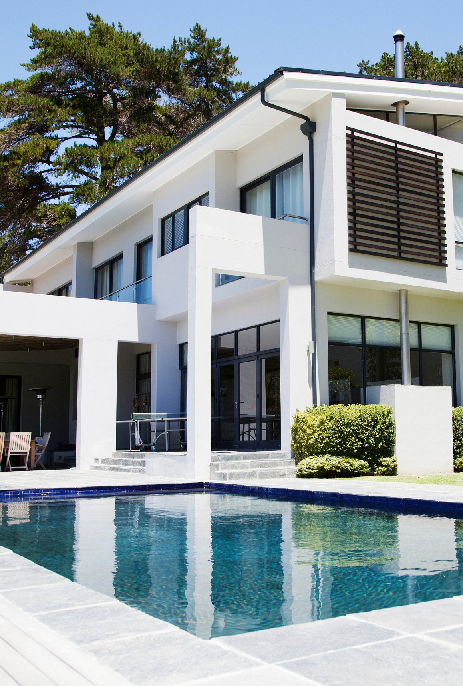

MANHATTAN BEACH
Top Solo Agents
#1 Candice Carpenter
#2 Jay Deai
#3 Carolyn Ro

Slide 10
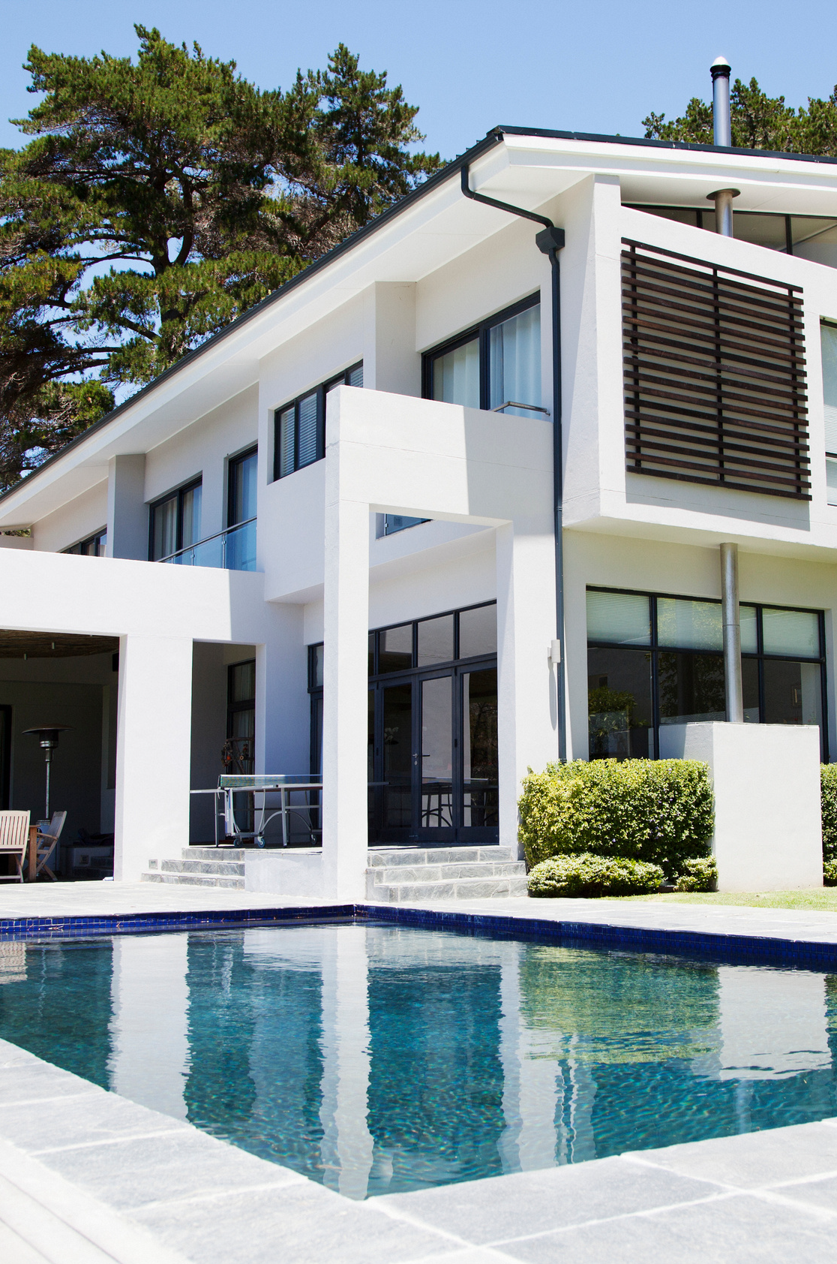
MANHATTAN BEACH
Top Teams
#1 The DOR Group

Slide 11
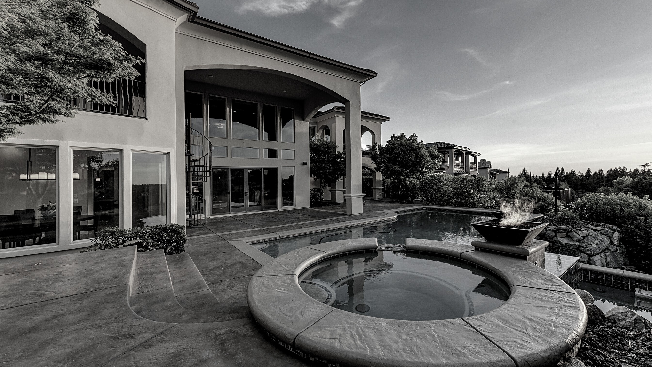
TOP AGENTS + TOP TEAMS
EL SEGUNDO

Slide 12
EL SEGUNDO
Top Teams
#1
Bill Ruane
#2 De Ann Eccles

Slide 13
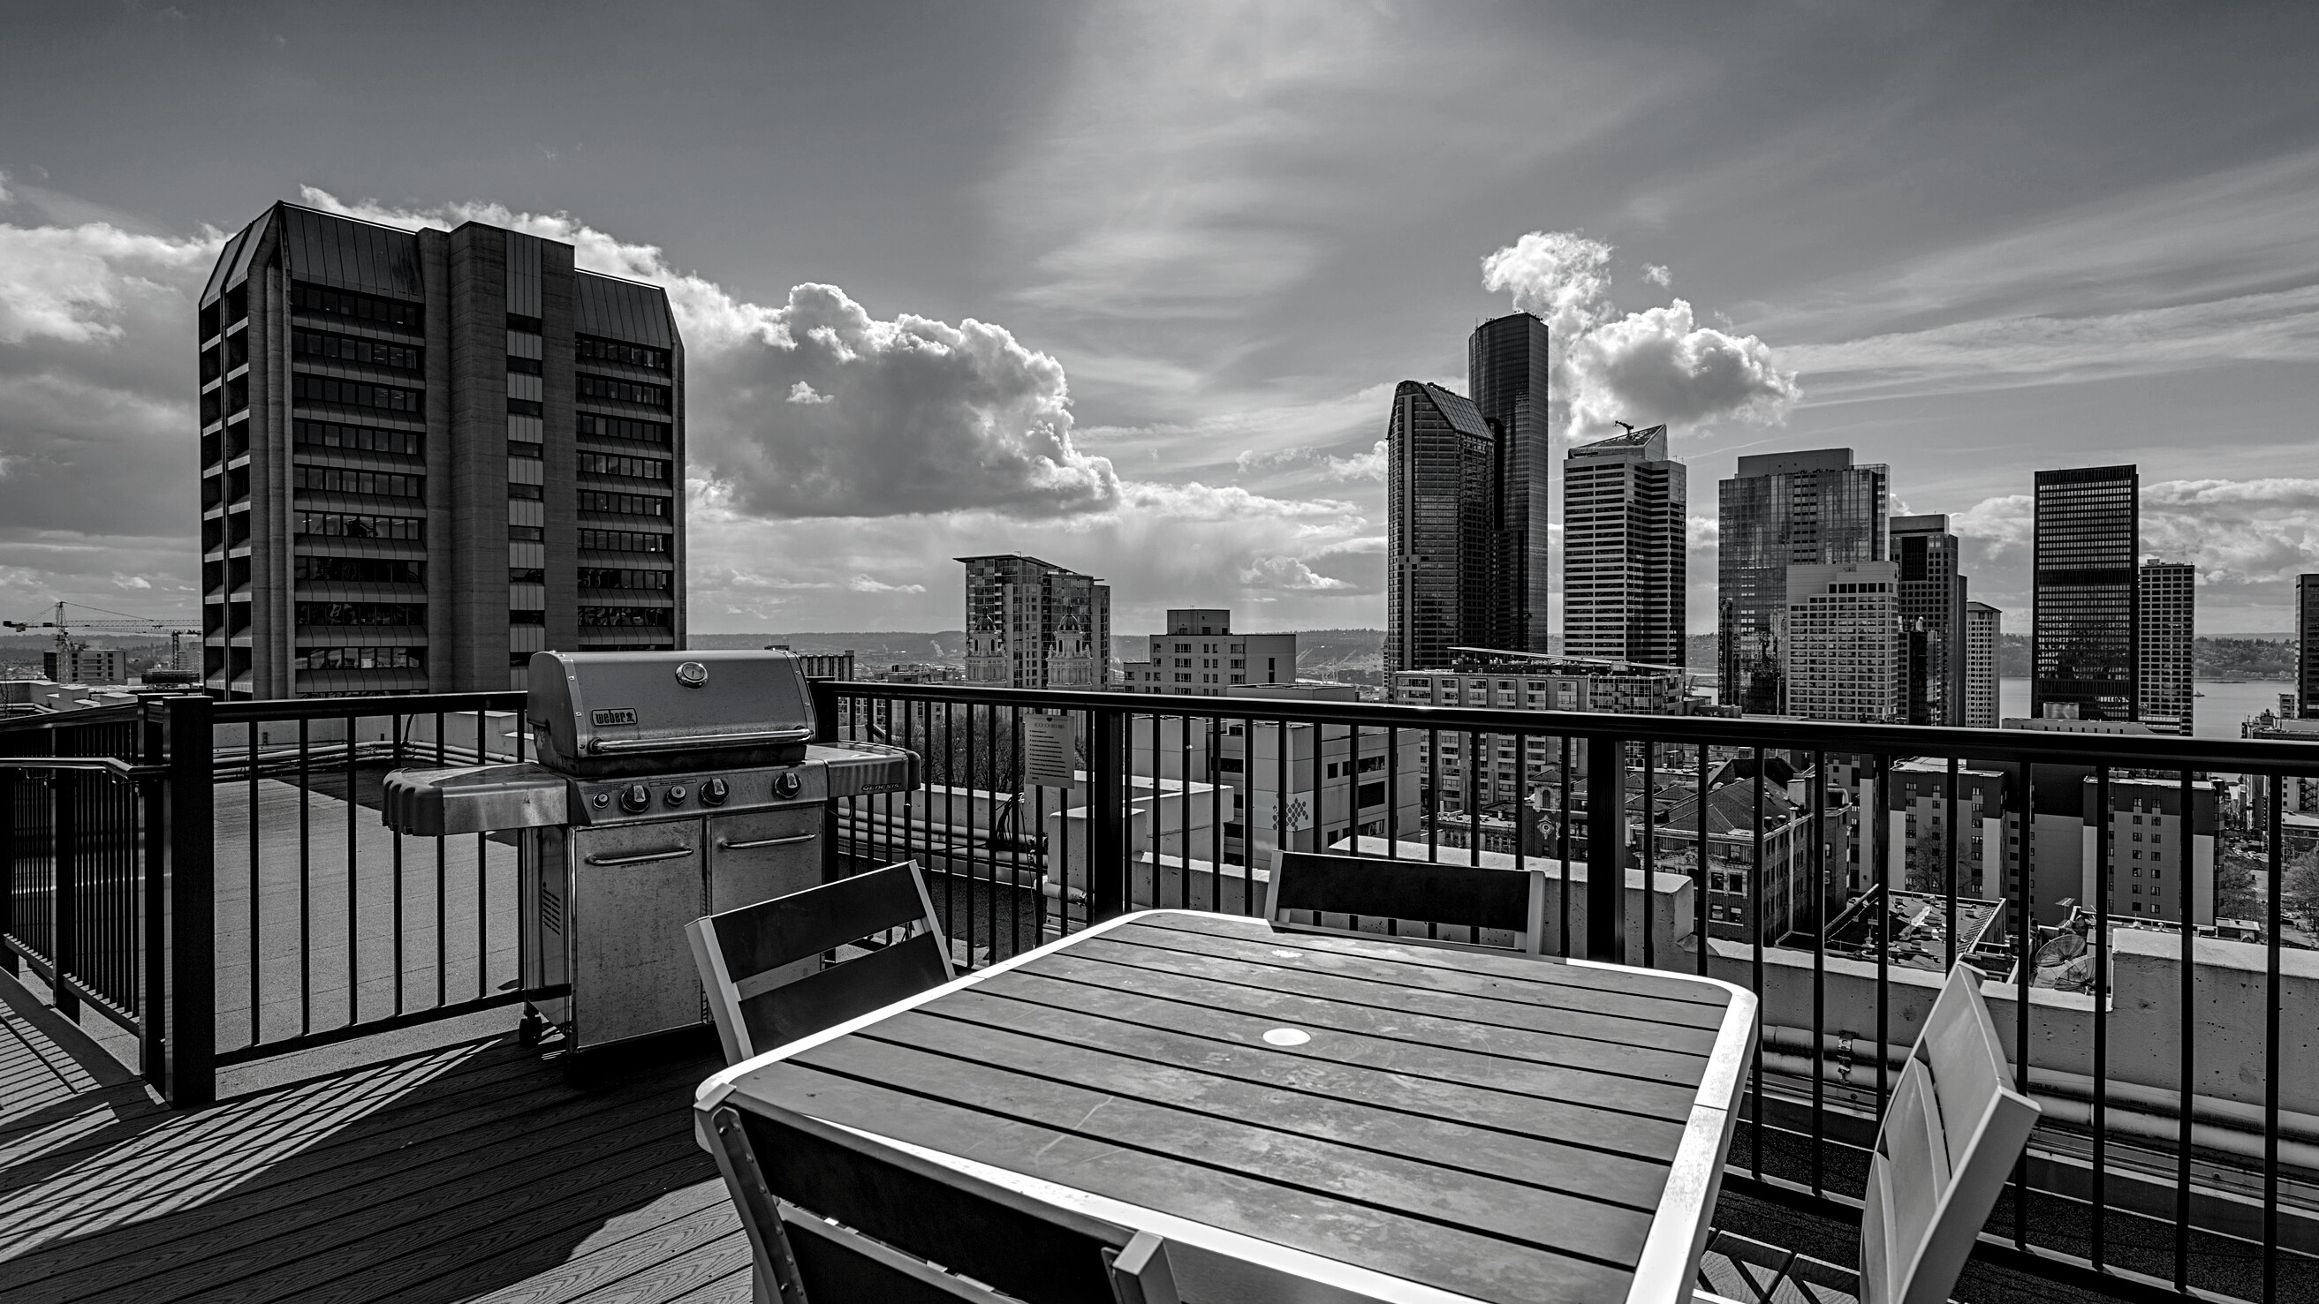
TOP AGENTS + TOP TEAMS
VENICE/ MARINA DEL REY

Slide 14

MARINA DEL REY
Top Solo Agents
#1 Joan Moon
#2 Betsy Goldman
#3 Michael Kayem

Slide 15
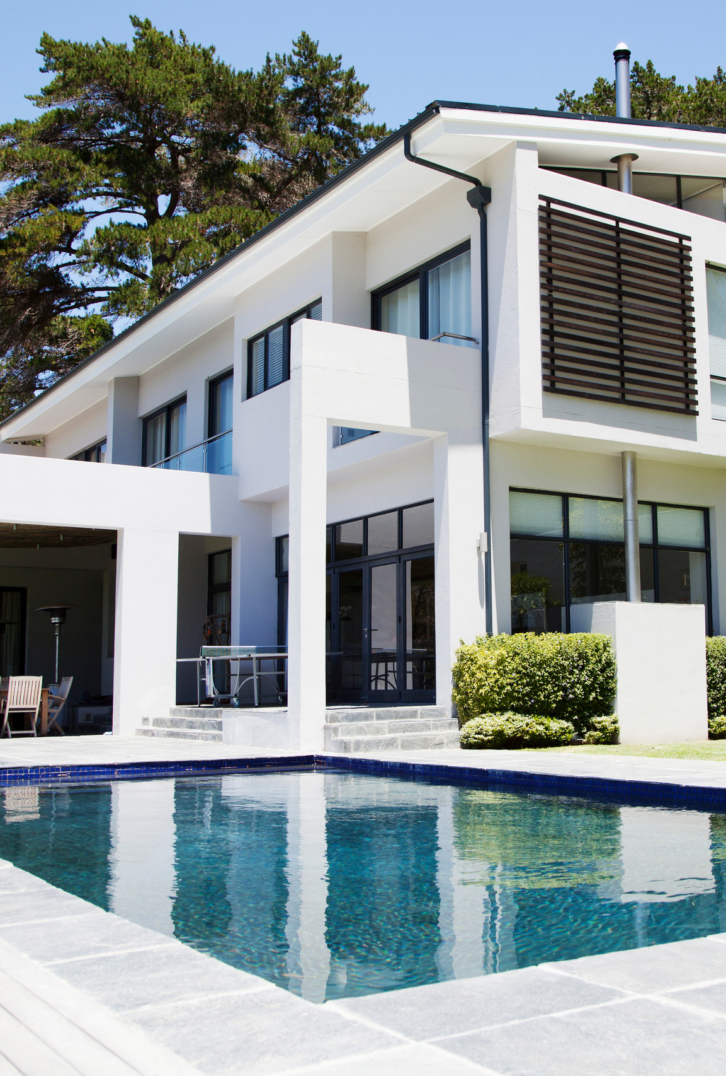
MARINA DEL REY
Top Team
#1 The Berman Kandel Team

Slide 16
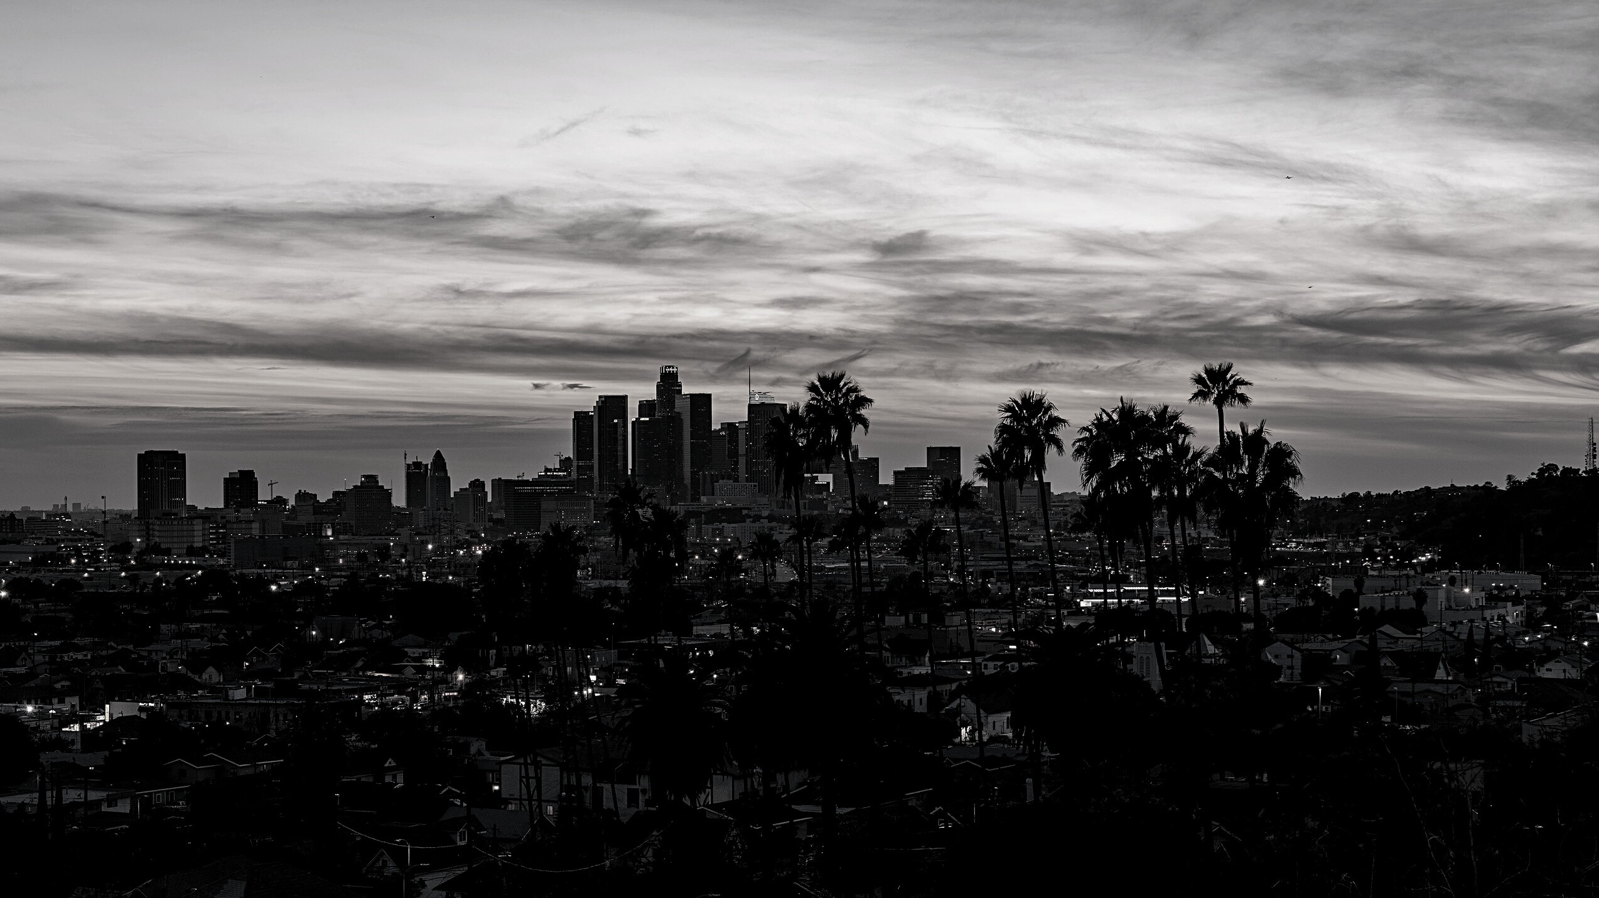
TOP AGENTS + TOP TEAMS
WEST LOS ANGELES

Slide 17
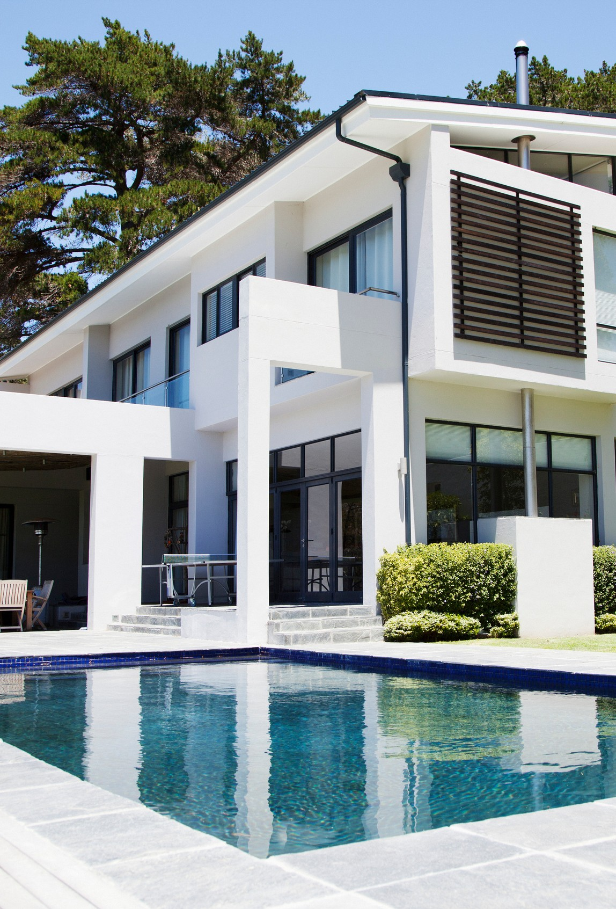
WEST LOS ANGELES
Top Solo Agents
#1 John Capiro
#2 Elizabeth Marquart
#3 James Brunet

Slide 18
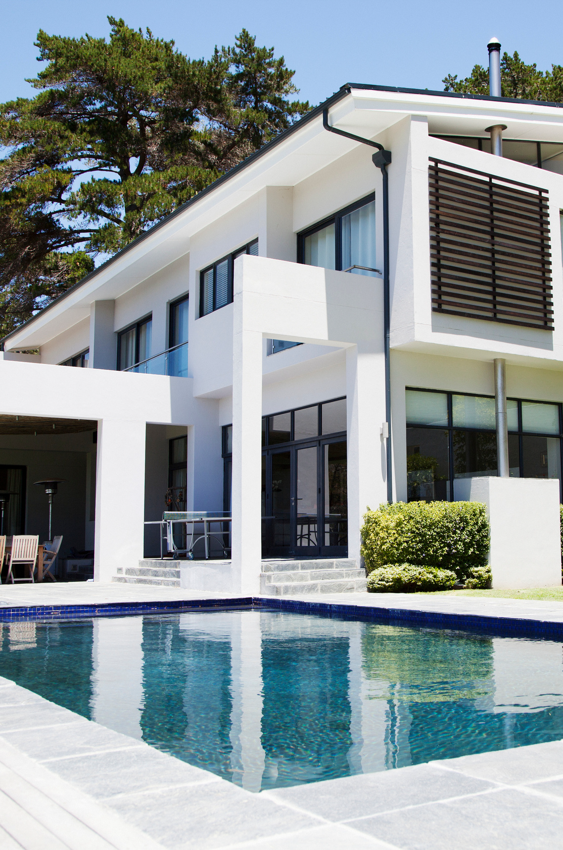
WEST LOS ANGELES
Top Teams
#1 Rory Posin & Kristian Bonk

Slide 19
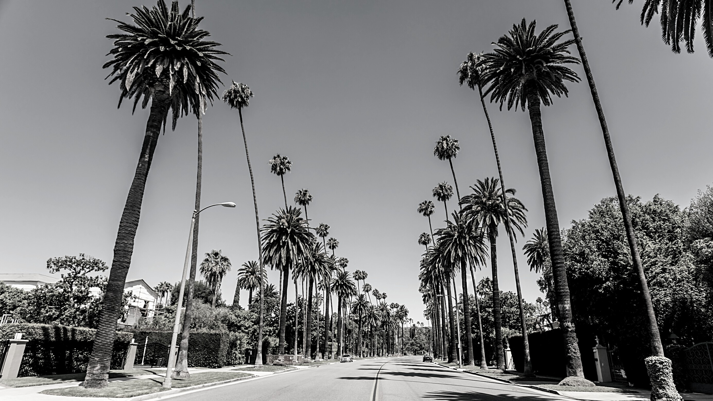
TOP AGENTS + TOP TEAMS
BEVERLY HILLS

Slide 20
BEVERLY HILLS
Top Solo Agents
#1 Saul Larner
#2 Eden Escamilla
#3 Jeannette Turcios

Slide 21

TOP AGENTS + TOP TEAMS
HIGHLAND

Slide 22

HIGHLAND
Top Solo Agents
#1 David Keller
#2 Gabrielle Herendeen
#3 Brittny Burford

Slide 23

HIGHLAND
Top Teams
#1 The Lemieux-Stott Team
#2 Team McGuire

Slide 24
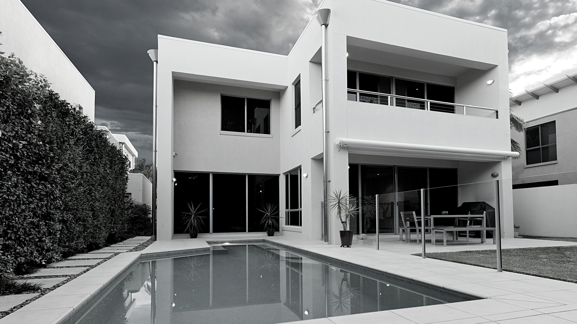
TOP AGENTS + TOP TEAMS
WESTCHESTER

Slide 25

WESTCHESTER
Top Solo Agents
#1 Laura Davis
#2 Elizabeth Campos Layne
#3 Theresa Lehr

Slide 26
WESTCHESTER
Top Teams
#1 RCRE Group
#2 Kevin & Kaz Gallaher Team
#3 Alex & Kate Eychis Team

Slide 27

TOP AGENTS + TOP TEAMS
MALGA COVE

Slide 28
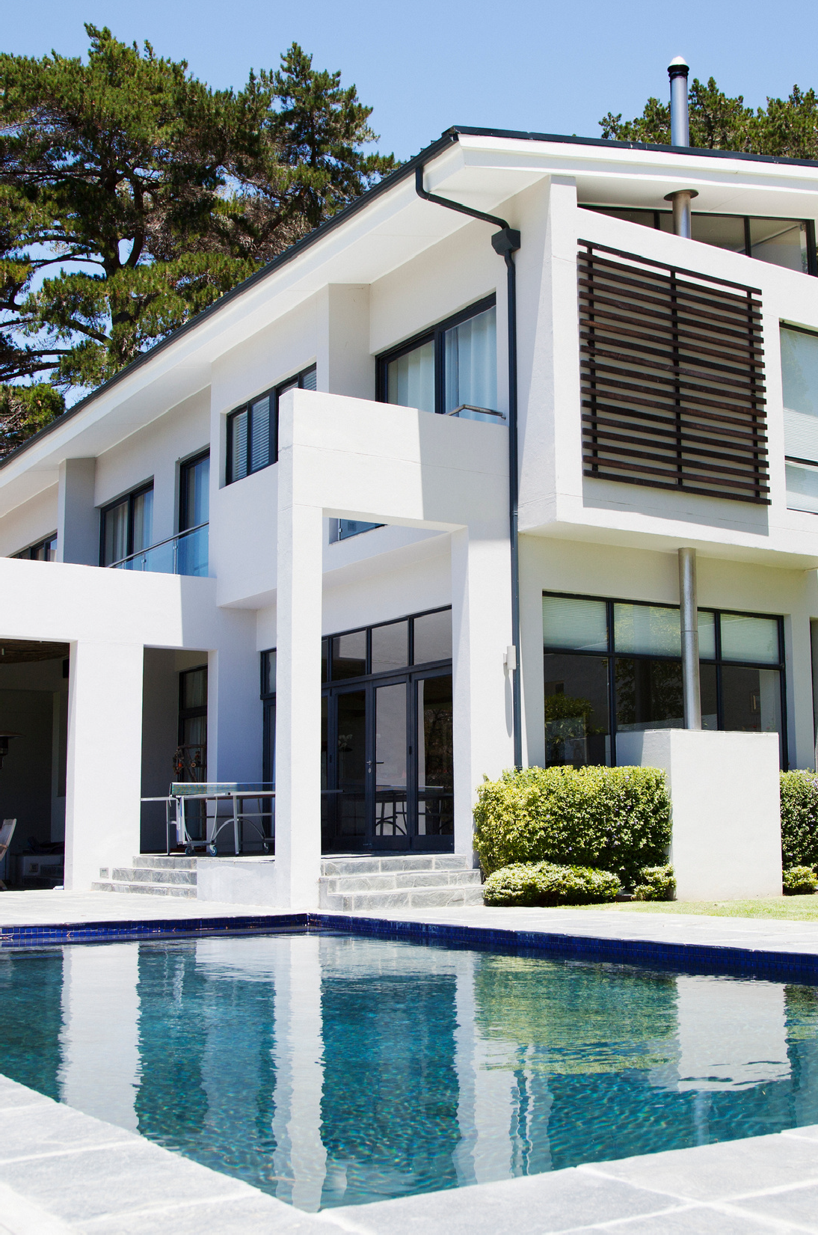
MALAGA COVE
Top Solo Agents
#1 Michael Talbot
#2 Igor Nastaksin
#3 Cynthia Chaisson

Slide 29

MALAGA COVE
Top Teams
#1 The Chamberlain Team #2 Lisa & Ramsey Oliveras _{#3} The Tyndall Team

Slide 30
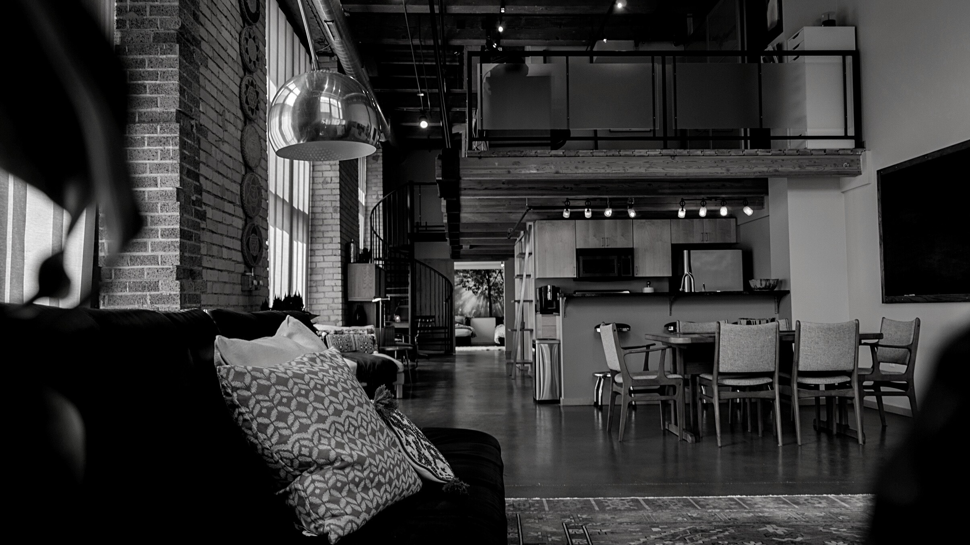
TOP AGENTS + TOP TEAMS
MIRALESTE

Slide 31
MIRALESTE
Top Solo Agents
#1 Jo Ann Travis #2 Nicole Trani _{#3} Haley Farrahi

Slide 32
MIRALESTE
Top Teams
#1 Jerry & Laura Yutronich Team
#2 The Todora Team

Slide 33
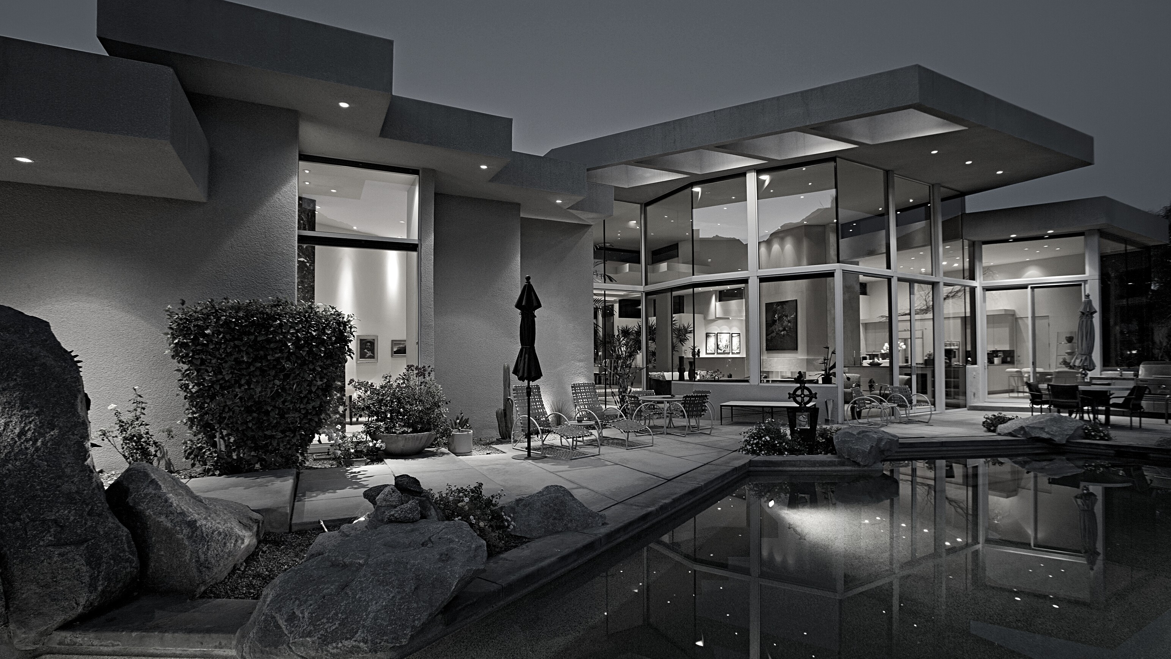
TOP AGENTS + TOP TEAMS
SILVER SPUR

Slide 34
SILVER SPUR
Top Solo Agents
#1 Greg Esaw #2 Gayle Probst #3 Megan Neel

Slide 35
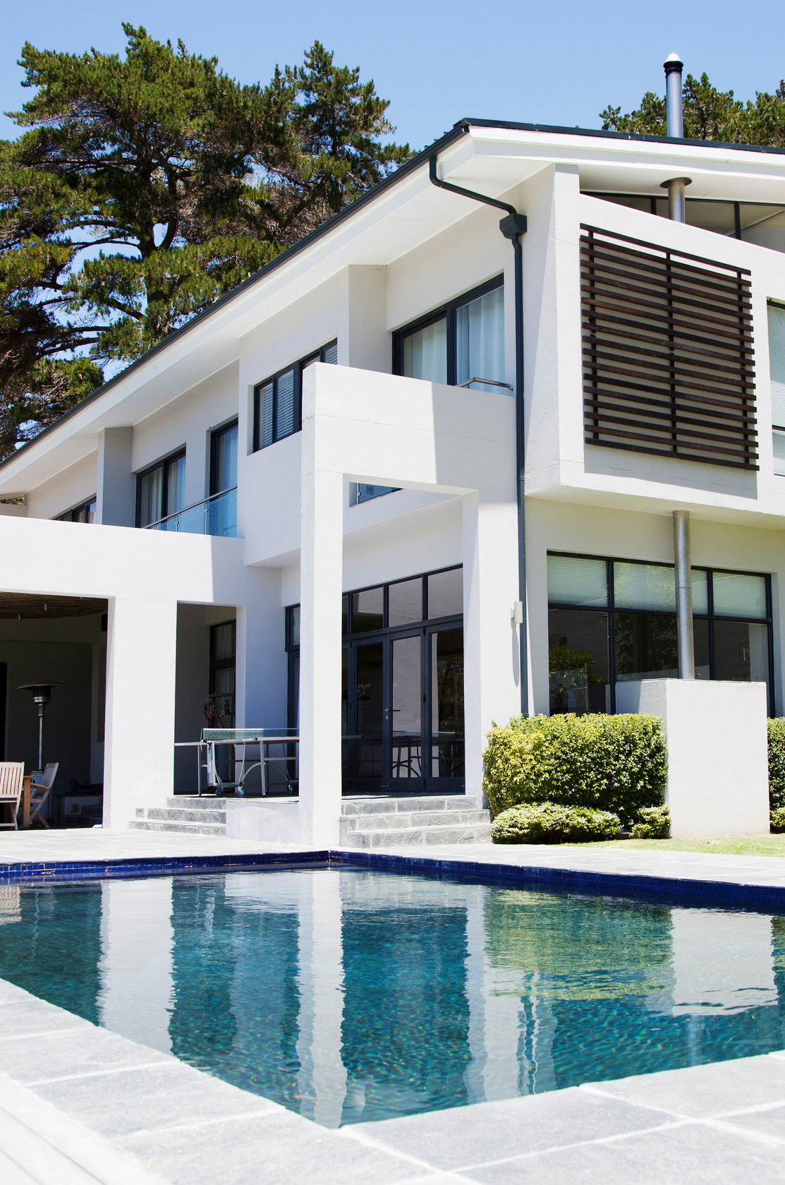
SILVER SPUR
Top Teams
#1 Cindy & Tiffany Kawata Team
#2 Sean & Jon Rodriguez

Slide 36

TOP AGENTS + TOP TEAMS
SOUTH BAY

Slide 37
SOUTH BAY
Top Solo Agents
#1 John Briscoe
#2 Melinda Brock
#3 Jenny Yamada-Clayton

Slide 38
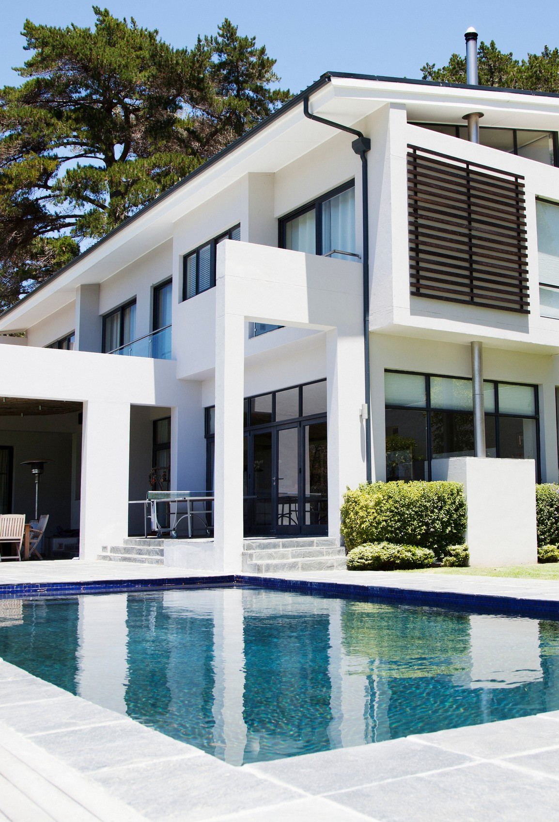
SOUTH BAY
Top Teams
#1 Manny & Marie Archondo
#2 The Lockwood Team

Slide 39
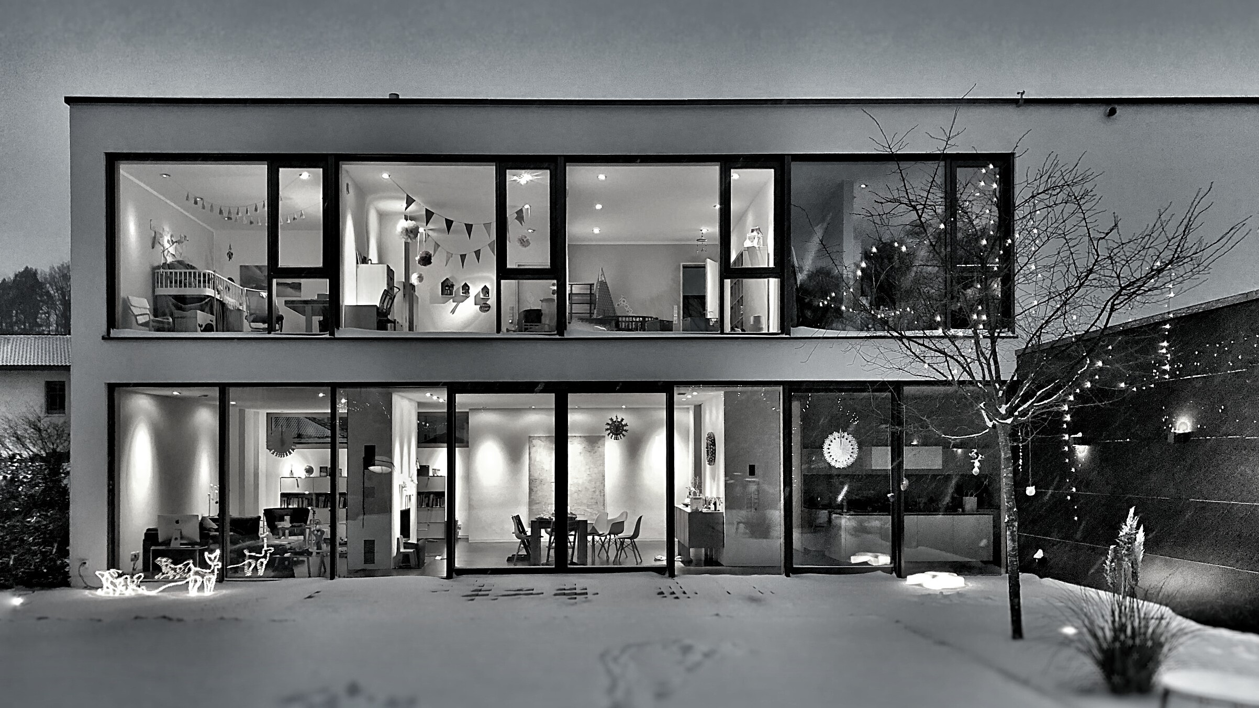
TOP AGENTS + TOP TEAMS
REDONDO BEACH

Slide 40
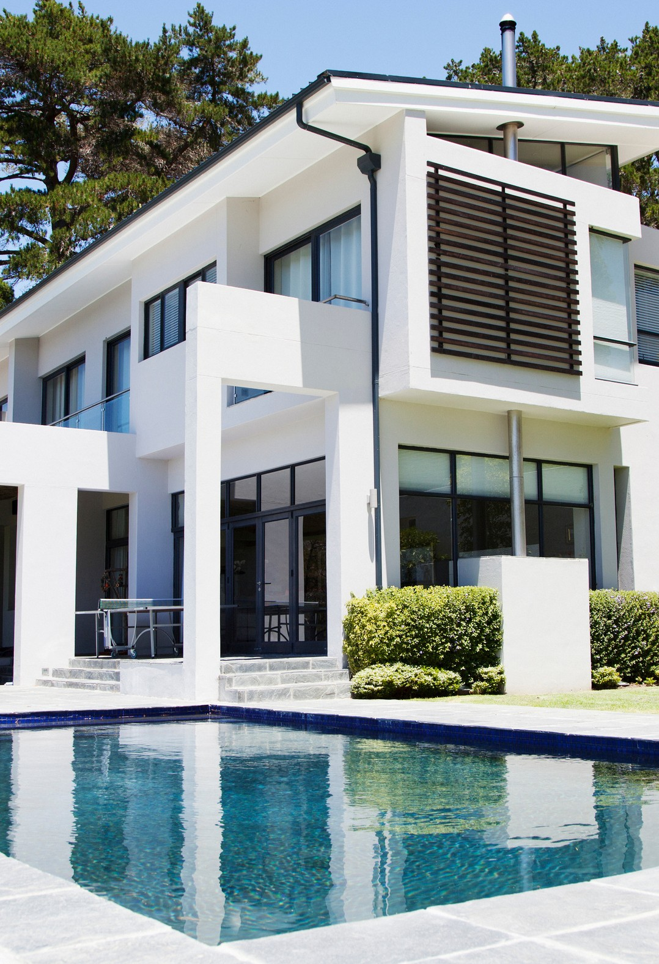
REDONDO BEACH
Top Solo Agents
#1 Michael Baker #2 Brent Talbot _{#3} Minday Fang

